Slide 1
Using Augmented Reality to give Instructions for Building LEGO Models
Oliver Reichmann
Graz, August 2020
Notes:
Hello and welcome to my presentation about my Bachelor thesis
Title: Using AR to give Instructions for building LEGO models

Slide 2
Motivation
Give instructions
No printed manual, no expert, no training
Building prototype with LEGO models
Notes:
motivation for this project: build application to show later used in real world,
Idea: instruction user build a machine without technichian, looking up in printed, without training, dumb
use Augmented reality
try it small scale LEGO models how good works

Slide 3
Outline
Augmented Reality
Requirements
Implementation
Challenges
Outlook
Demo
Notes:
In my pres first tell you what Augmented Reality, what used for
Then requirements for the application
How we implemented them
challenges we faced
end an outlook what change, add make it even better
At the very last I will video of app in action

Slide 4
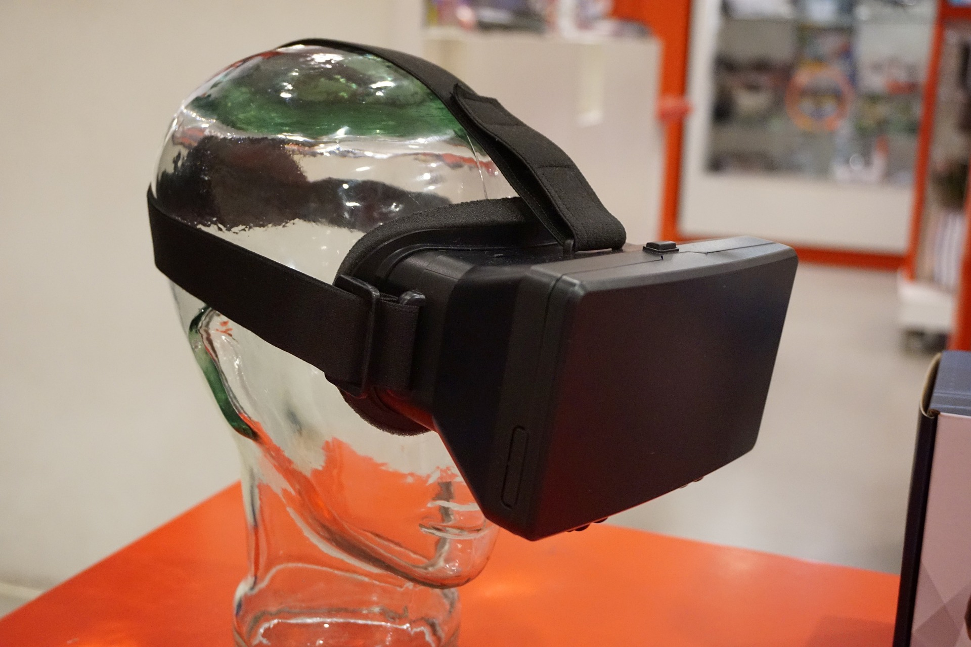
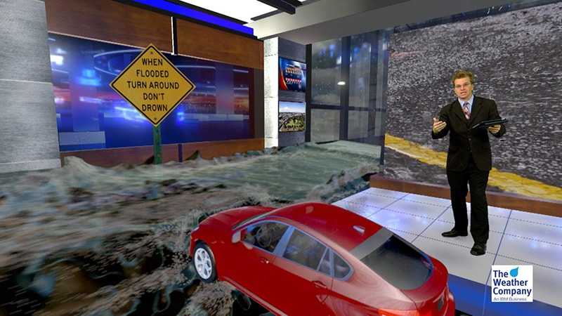
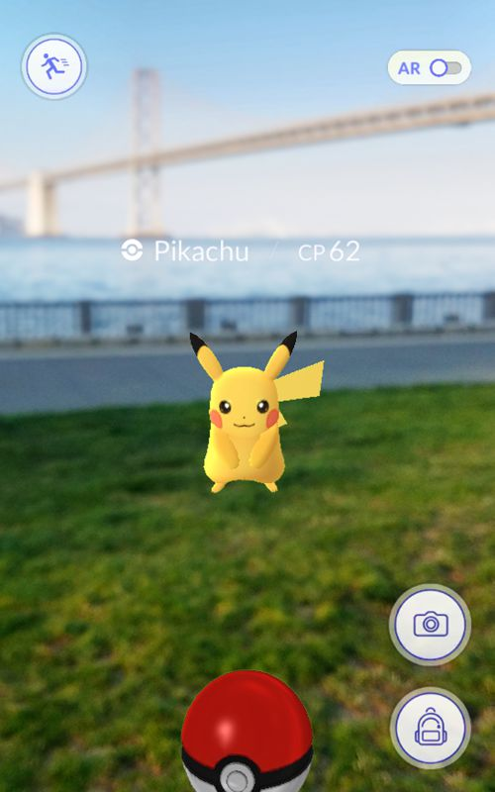
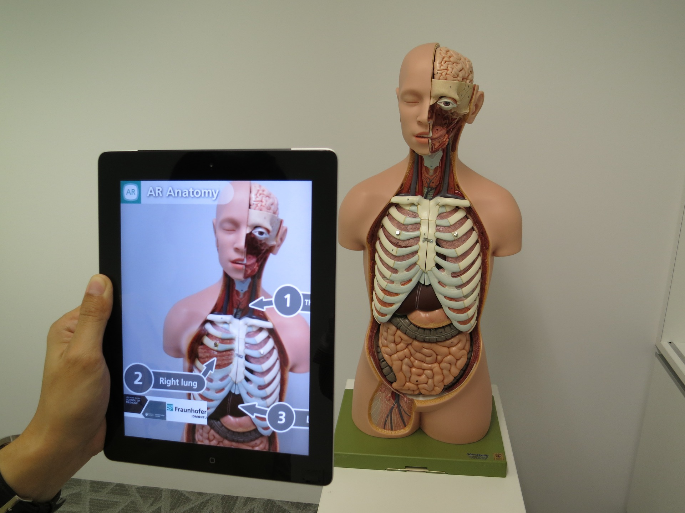
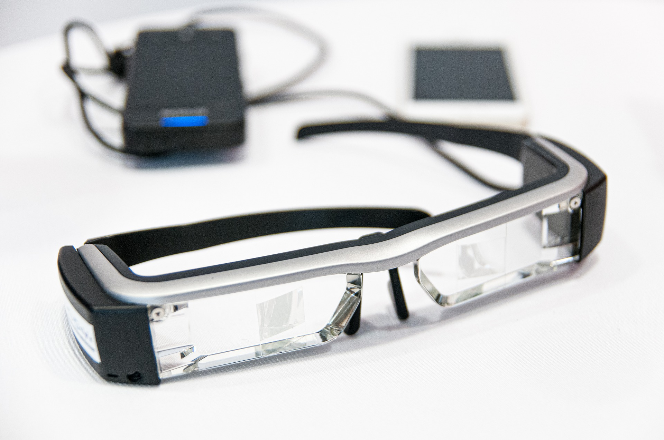
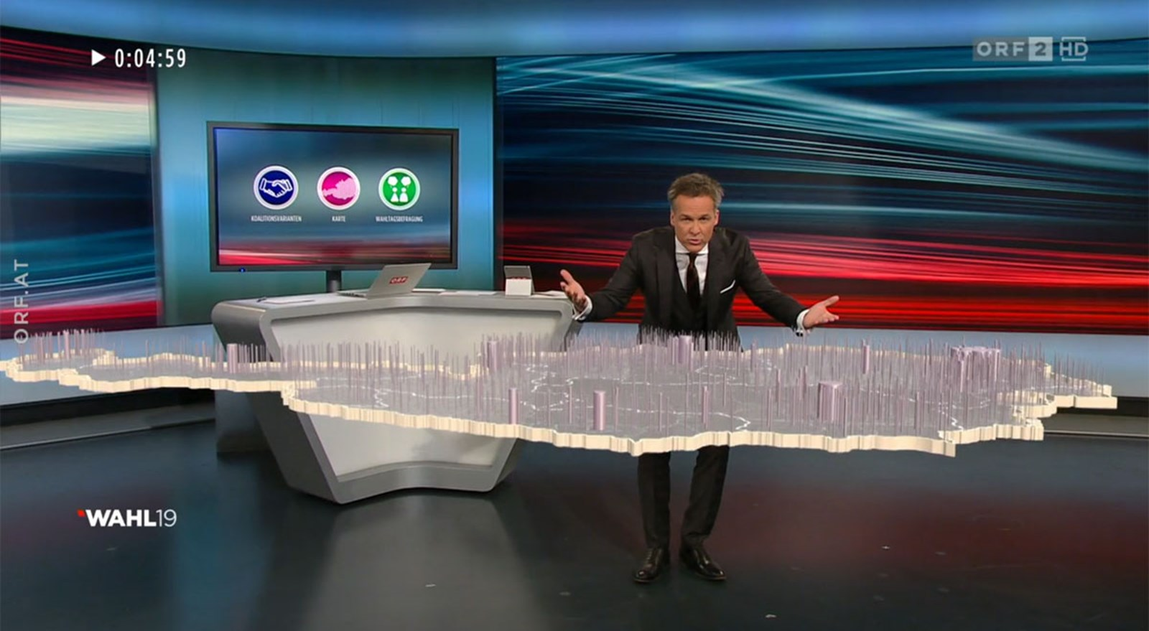
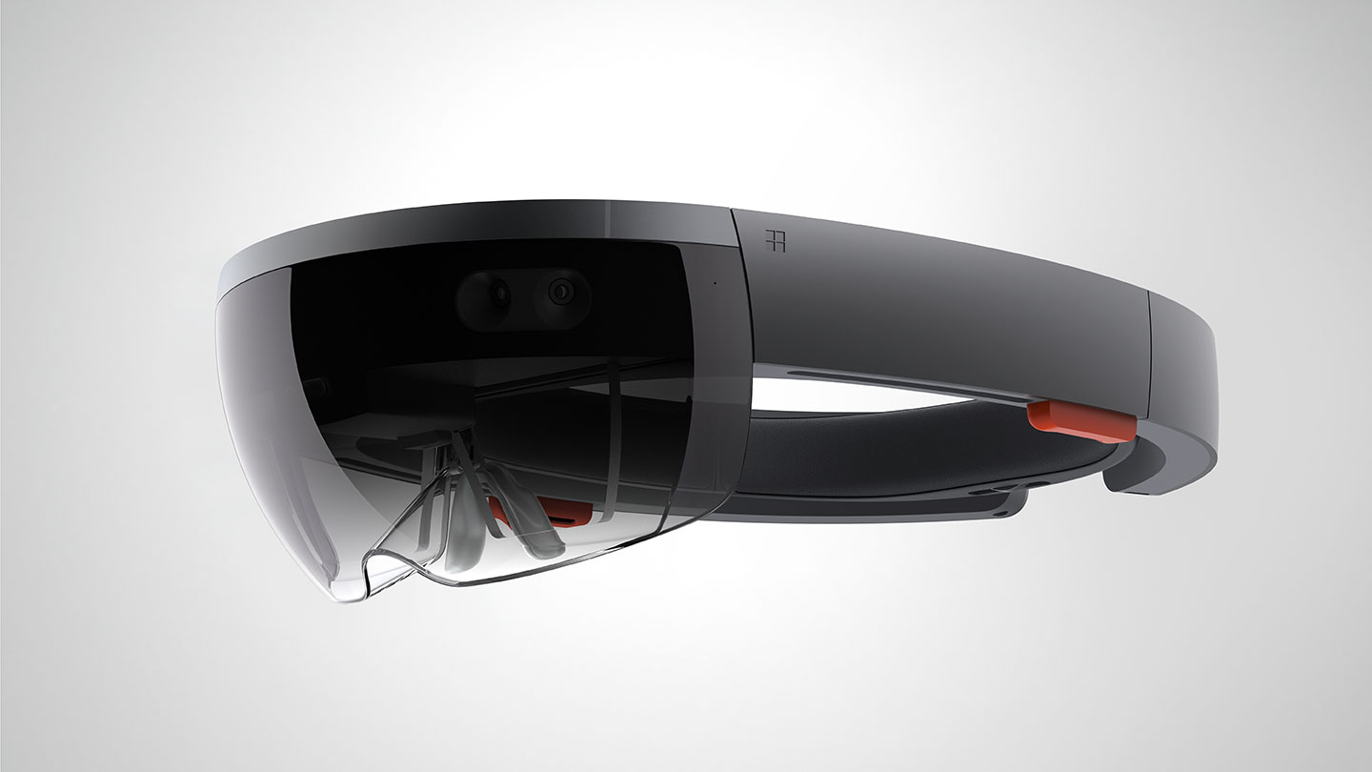
Augmented Reality
Add Information to real world
Devices:
Head Mounted Displays
Phones
Use Cases:
Information/Instructions
Games
Architekture
TV
https://www.ibm.com/products/max-reality
https://www.derstandard.de/story/2000109270202/oesterreich-flach-gelegt-die-fliegenden-wahlgrafiken-des-orf
https://www.wevolver.com/wevolver.staff/hololens.gen.1
https://pokemongolive.com/en
Notes:
Goal: add inform to real world, other than VR which replaces
takes what is there and enrichens artificial fig or text
Ideally as real as possible and blends in
usally head mounted displays like we see here…
phones used often: available to everyone, other than HMD, have good enough hardware.
HMD prefered hands free
Use cases: instructions, extra info
games: Pokemon go, like we see here, phone and overlaying models
Architekture: plan in advance, give ideas how look, construction workers idea to build, also old ruins, show how looked like
TV: common: weather display, bring it in studio, statistics for elections like ORF

Slide 5
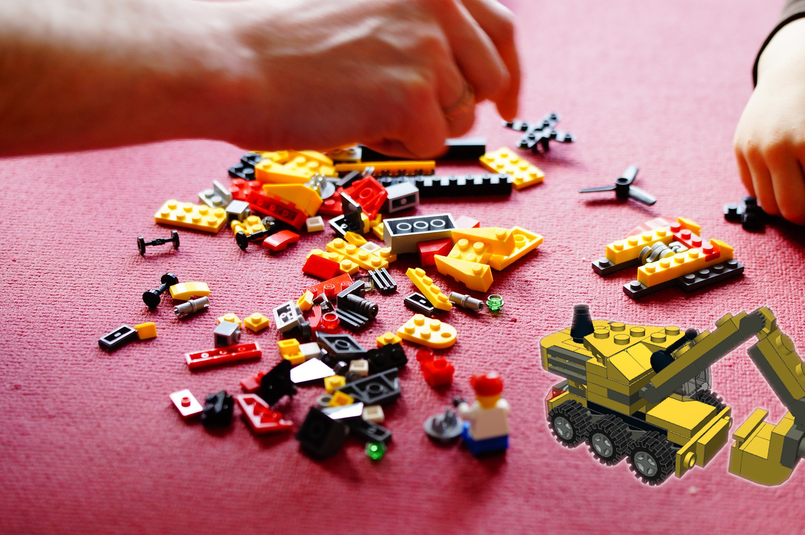
Requirements
Head Mounted Device
Model Picker
Step by Step Instruction
Voice Input
Movable and Scalable
Highlighting
Notes:
Requirements for app:
head mounted, better than phone bc need our hands phone is worse option
sort of start screen, pick from different models
step by step instr: model files or brick per brick backup
voice input to get next or last step so without hands
models movable, scalable: see model from all sides, angles, sizes
current step bricks highlighted, see better and know where to put

Slide 6
Implementation
Hardware
HoloLens
Software
Python, Unity/C#/MRTK
Different File Formats
2 Steps
Preprocessing Model
Unity App
https://www.wevolver.com/wevolver.staff/hololens.gen.1
Notes:
For our implem used Microsoft Hololens as Head mounted display to show instr
Software Python for prep models, Unity which uses C sharp to build app for HL, made use of Mixed reality Toolkit: collection of components and features from Microsoft for mixed reality app development in unity
Models: set of different file formats: ldraw: open standard for LEGO CAD (describe lego models), wavefront obj: loading files in unity
2 step approach, first preprocess ldarw file, the show in unity app

Slide 7
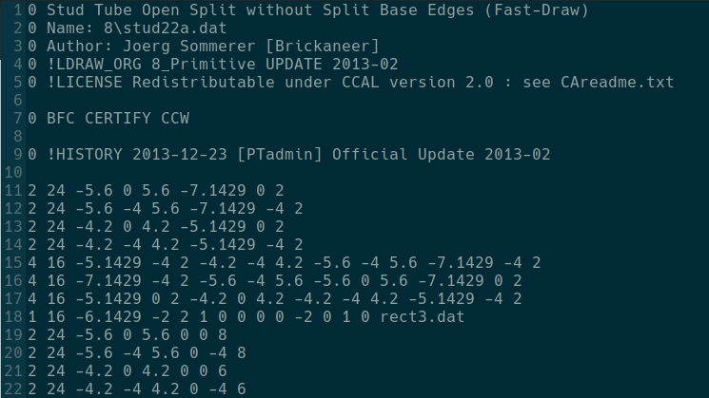
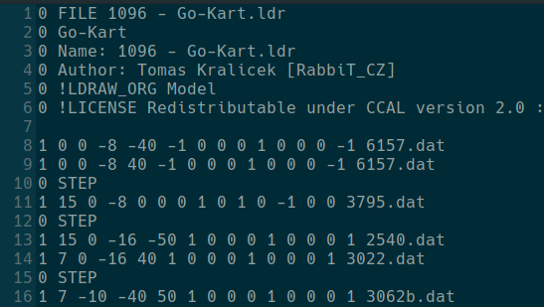
Step 1: Preprocessing
Input
LDraw files: .ldr, .mpd
Output
.obj Step files
.obj Preview file
.mtl Material file
Asset Bundles
Notes:
Preprocessing: 2 different input files: ldraw, we can see here, or multi part documents, .mpd: collection of ldraw files copied together
see: ldraw file reffering to other, indic line number 1
Here one of .dat files with infos, line type 2 …
Script: seperate model for steps writes to .obj file
writes one file: whole model, preview, should look like
.mtl, the material template library: tells materials used in .obj, scipt writes depending on colors used pe step
After preproc: create asset bundles in unity so use models in app, have to open unity editor do per hand

Slide 8
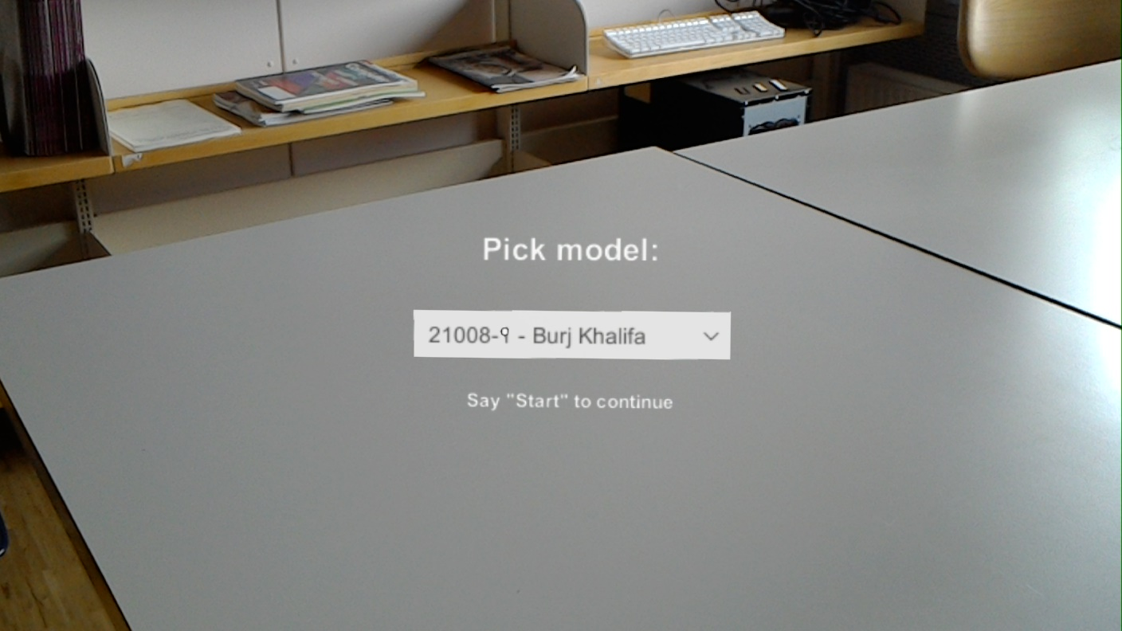
Step 2: Unity App
Model Picker
Voice Commands
Preview
Highlightig
Notes:
The second step: Unity app for hololens
Simple user interface, drop down menu to pick model
Start the instructions: keyword start. Other comands:
next, last to switch steps,
back to return to picker,
drop: turn on gravity,
come back: lose model, appear in front, gravity turned off
upper right: model preview as can see
color difference of bricks in two models, preview: step by step: highlighted white

Slide 9
Step 2: Unity App
Model Picker
Voice Commands
Preview
Highlightig
Notes:
The second step: Unity app for hololens
Simple user interface, drop down menu to pick model
Start the instructions: keyword start. Other comands: next, last to switch steps, back to return to picker, drop: turn on gravity, come back: lose model, appear in front, gravity turned off
upper right: model preview as can see
color difference of bricks in two models, preview: step by step: highlighted white

Slide 10
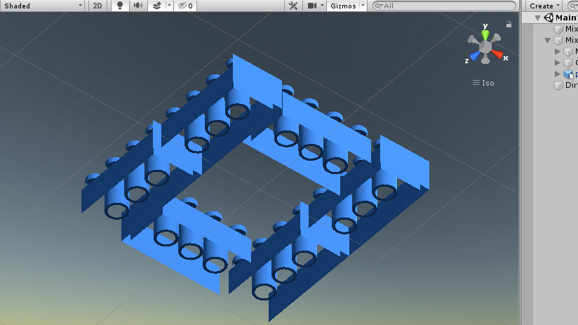
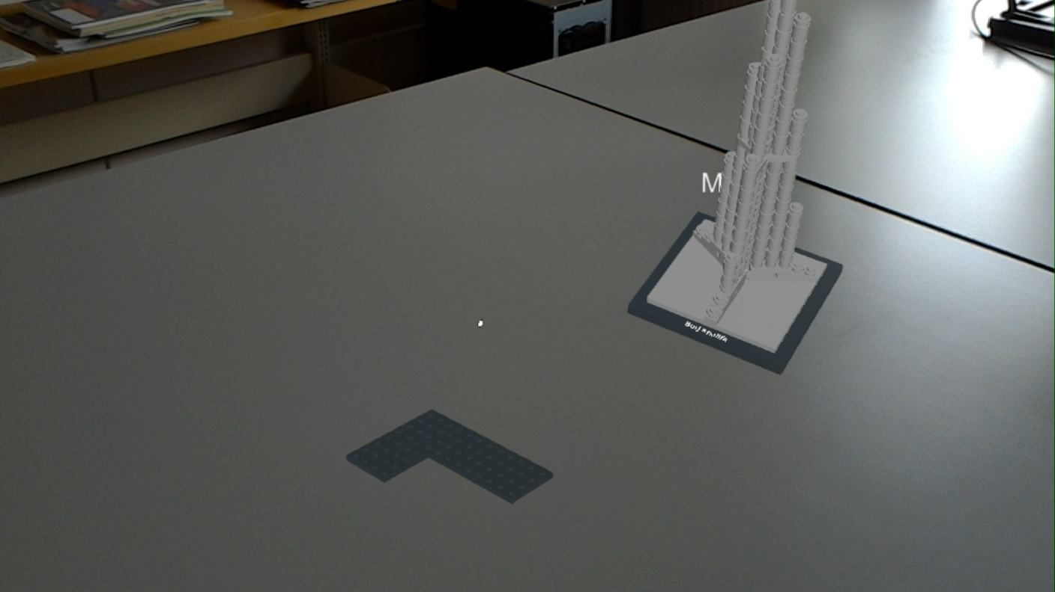
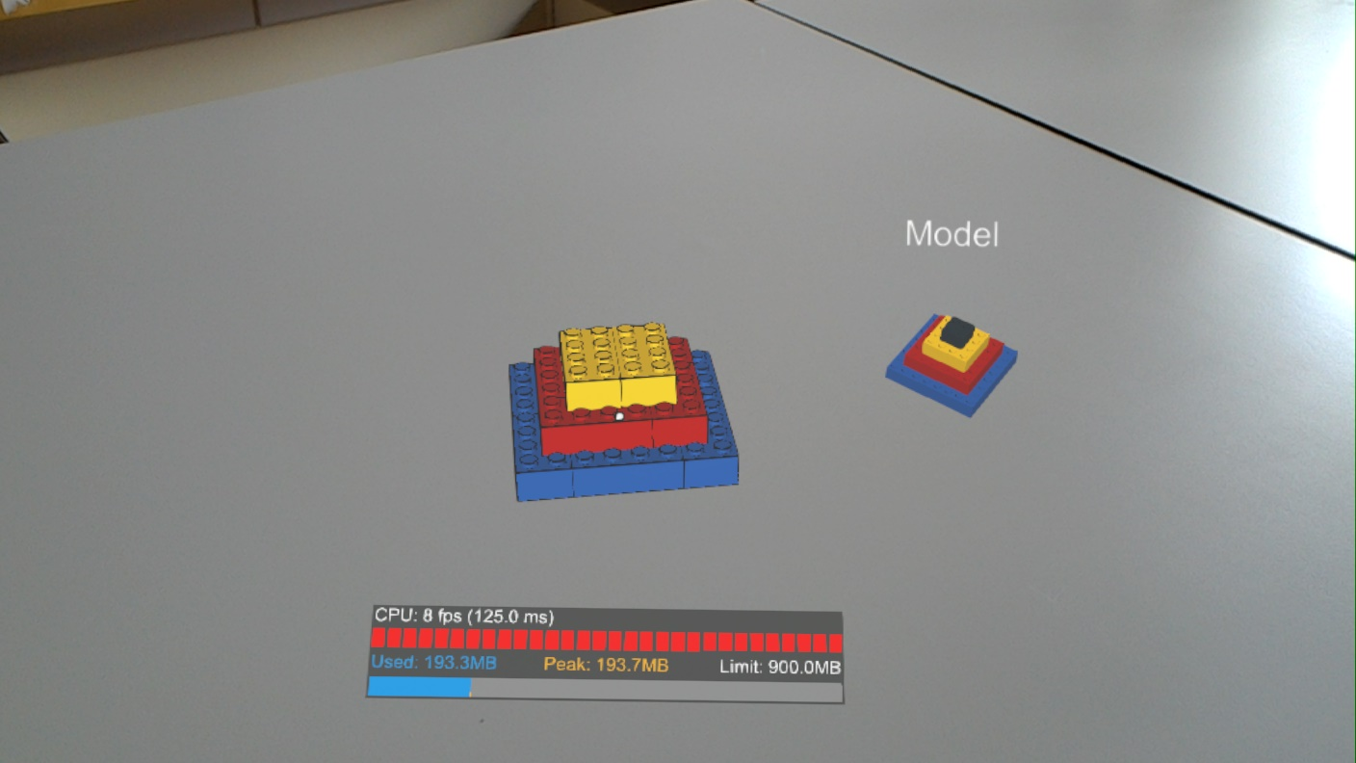
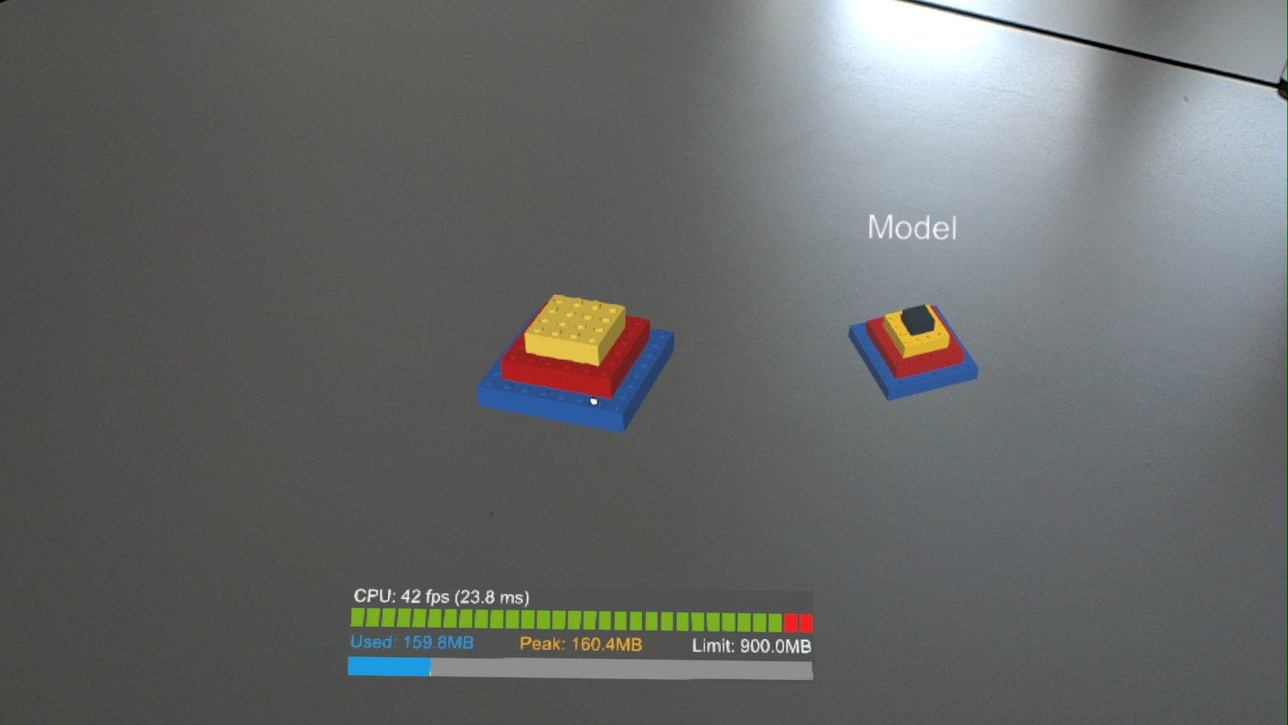
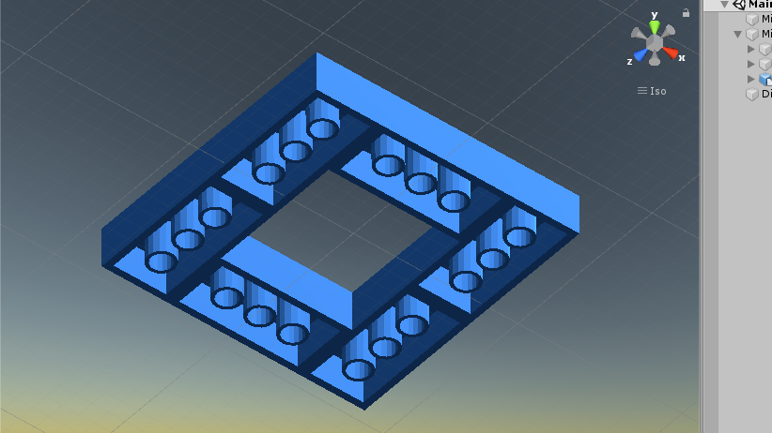
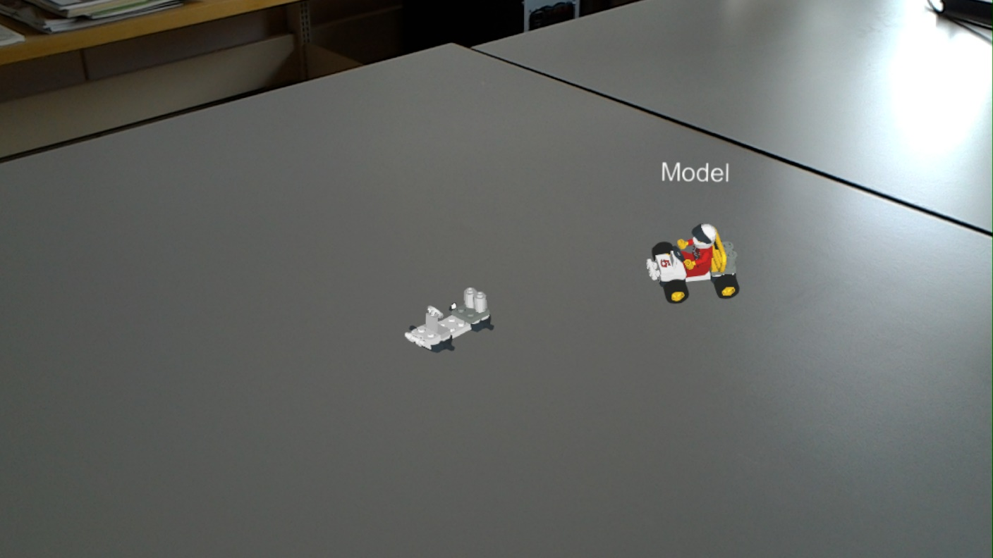
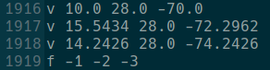
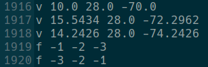
Challenges
Preprocessing Orientation
Color
Double Sided Shading
Lines Performance
Preview Scaling
Runtime Model Adding
Notes:
couple of challenges on the way
real problems get models right: ldraw: referrencing other files a lot, reuse common forms, a lot translations matrices, every file referred to: own translation matrix, has to be translated with old
get the right color for faces, Ldraw: color codes: translated to rgb colors, .obj: either vertex colors or .mtl, first: vertex, unity cant parse, switched
Obj: points, extra line face, referring/indexing to points as we can see here, problem: one outside is shaded, other side transparent as we can see here. Fix: write own shader, define face double but other way around, normal points to other side, outside is other
different problem: Lines. Defined in ldraw, written in obj, unity parser doesnt understand and show, fix: write to text file and parse in unity, but performance not acceptable, so leave them out.
Preview scaling: hard to get right scaling with different models, 3 bricks vs whole building: solution: bounding box and scale to box
Runtime model adding: first scene for every model, no new could be added, not runtime, solution: multiple approaches, easiest: ressouce folder, need them all while building app, models get added to build, gets big. Asset bundles saved in streaming asset folder, load from there, good for futur, more on that in next slide

Slide 11
Outlook
Optimizations
Delete unseen Vertices/Faces
Additions
Detection
Additional Information
Changes
Real Runtime Loading
Notes:
Look back process: few things can change, make better to improve app
Optimization purpose: first preprocessing step delete verticies/faces not seen, ldraw specifies ever brick extra, but finished model: bricks at inside: neglected, smaller model files
Useful addition: brick/model detection implemented to find brick in the current step out a pile or detect real model, glue virtual one
additional info, like preview, currently used brick
very useful change: model loading, Rn: every asset bundel prebuild, save in the streaming asset folder before starting, get rid: download bundles at runtime from webserver to this folder, preprocessing done by developer, user downloads app and has every avilable model

Slide 12
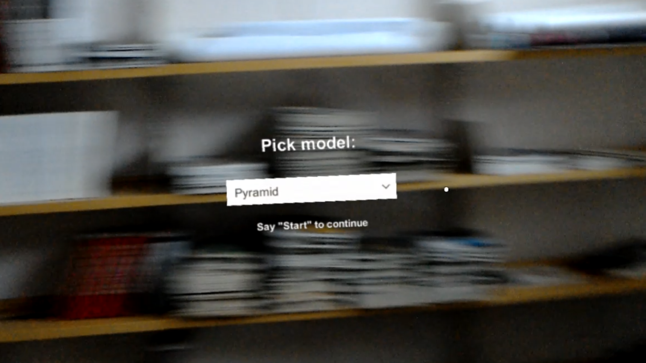
Demonstration
Notes:
In the end: short demonstration video of application, filmed with the internal camera of hololens

Slide 13
Demonstration
Notes:
In the end: short demonstration video of application, filmed with the internal camera of hololens

Slide 14
Questions?

Slide 15
References
LDraw.org. LDraw. url: https://www.ldraw.org (visited on 07/23/2020).
Microsoft. Microsoft HoloLens. url: https://www.microsoft.com/en-
us/hololens (visited on 07/23/2020).
Microsoft. Mixed Reality Toolkit for Unity. url: https://microsoft.
github.io/MixedRealityToolkit- Unity/README.html (visited on
07/23/2020).

